Slide 1
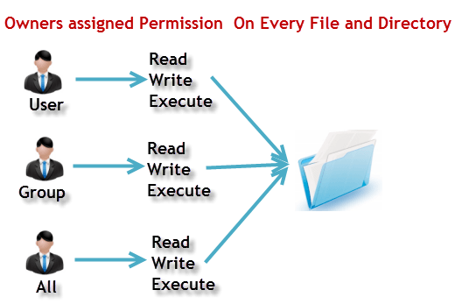
Cloud Solution Architect
Module 2
Lecture 6
Linux User Permissions
Disk Partitions
LVM
run levels

Slide 2
Recap
Module 2 - Lecture 5
  Bourne-Again Shell (bash)
  Linux Kernel
  User Management
  System Administration

Slide 3
Learning Objectives
Module 2 - Lecture 6
  Linux Permissions
  Disk Partition / Logical Volume Management
  Run levels / init / systemd

Slide 4
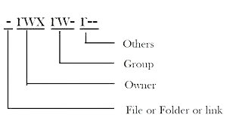
Linux permissions
  User (u): Owner of the file or directory
  Group (g): Group of users added to have similar permissions
  Others (o): anyone else other than owner and the group

Slide 5
Linux permission Types
  Read (r): Read the contents of a file
  Write (w): Write and edit the contents of a file or a directory
  Execute (x): Execute a program that is written in a file or directory

Slide 6
Linux permission Types
  Read has value 4
  Write has value 2
  Execute has value 1

Slide 7
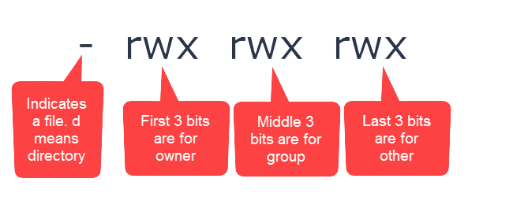
Linux permission String
  10 characters in Linux Permission String (output of ls -al)
    First Character is the type of the file,
    The first three characters of the remaining nine characters are permissions for the user
    The middle three characters are permissions for group
    Last three characters are permissions for others

Slide 8
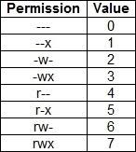
Linux permission Matrix

Slide 9
Linux permission Symbolic
  User => u
  Group => g
  Others => o
  All => a
  read => r
  write => w
  execute => x
  + => add
  - => remove
  = => set

Slide 10
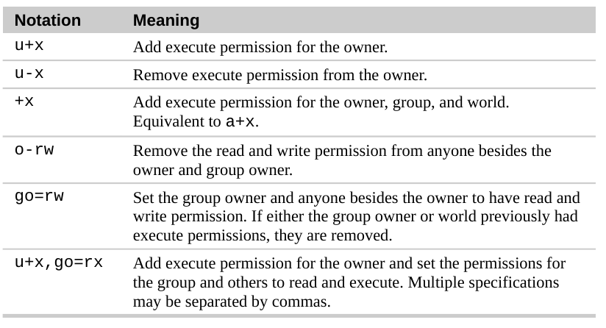
Linux permission Symbolic

Slide 11
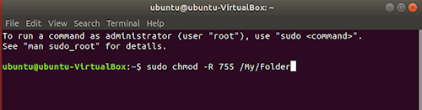
chmod - Change Mode
  chmod command is used to change the permissions of a file or directory
    chmod [permissions] [filename]
    chmod -R [permissions] [directoryname]

Slide 12
chown - Change Ownership
  chown command is used to change the ownership of a file or directory
    chown [user:group] [filename]
    chown -R [user:group] [directoryname]

Slide 13
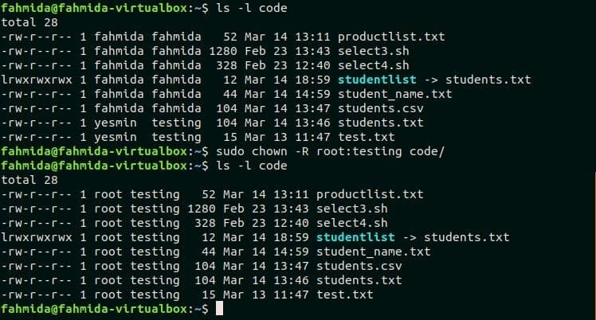
chown - Change Ownership

Slide 14
Disk Partition - Linux
  Creation of one or more regions on secondary storage
  Created to manage regions separately
  The first step of preparing a newly installed disk
  Done before creating file system

Slide 15
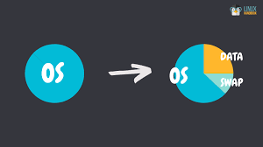
Disk Partition - Linux
  data partition: normal Linux system data, including the root partition containing all data to start up and run the system
  swap partition: expansion of computer's physical memory, extra memory on hard disk.

Slide 16
parted
  sudo parted -l //list the devices
  list contain
    model of the storgae device
    Name and size of the disk
    logical and physical size of the disk
    Type of partition table
    information about size, type, file system, and flags
  Select disk that needs to be partitioned
    sudo fdisk /dev/sdb

Slide 17
parted
  if not selected the right disk, use the 'select' command in parted interface
  mklabel gpt //select the partition table as shown in parted -l
  'print' to confirm the selection
  mkpart primary ext4 1MB 1855MB
    This will create a primary partition of 1854 MB with an ext4 file system
  partition can be
    primary: Hold OS files. Max 4 partitions
    extended: Special partitions, can be more than 4
    logical: Partition inside extended partition

Slide 18
fdisk
  creating and manipulating disk partition table
  Partition functions
    view
    create
    delete
    change
    resize
    copy
    move

Slide 19
fdisk
  fdisk -l //list the partition table
  fdisk -l /dev/sdb //specific disk
  fdisk /dev/sdb //to open command interface for fdisk
    m //list the fdisk commands
    p //print the partition table for specific disk
    d //delete partition
    w //write the partition table after changes
    n //new partition
      p //primary
      e //extended
  fdisk -s partition //check size of a partition

Slide 20
fdisk
  Format partition when created
  mkfs.ext4 newly-created-partition
  Partition:
    physical subset of a disk
  filesystem:
    logical hierarchy of directories and files

Slide 21
File Systems
  NTFS (New Technology File System)
    Partition can extend upto 16EB (16 million TB)
    Files stored can be as large as the partition
    ocassionally becomes fragemented and should be defragmented every one to two months
    read from and write to Windows and linux, whereas read from MacOS X. However, can written using NTFS-3G driver

Slide 22
File Systems
  FAT (File Allocation Table)
    Cannot exceed 2TB
      (Windows cannot form larger than 32GB, Mac OS X can)
    partitions larger than 32GB are not recommended
    Files stored cannot exceed 4GB
    need to be defragmented often to maintain reasonable performance

Slide 23
File Systems
  exFAT (Extended File Allocation Table)
    partitions can extend up extremely large, max 512TiB (Tebibyte)
    Files up to 16EiB can be stored
    not compatible with Linux/Unix
    should be defragmented often
    cannot pre-allocate disk space

Slide 24
File Systems
  HFS Plus (Hierarchical File System)
    Max Volume is 8EB
    Files can be as large as the partition
    Windows users can read but not write
    Drivers are available that allows Linux users to read and write in HFS+ volumes.

Slide 25
File Systems
  EXT (extended file system)
    was created to be used with the Linux kernel
    ext4 is the most recent version
    max volume up to 1 EiB
    16 TB max file size
    XFS is recommended by RedHat for voluume over 100TB
    ext4 is backward compatible with ext3 and ext2
    can preallocate space
    windows and mac OS cannot read ext file system

Slide 26
Logical Volume Manager (LVM)
  Logical Volume Manager or LVM
  A method of flexible disk space management
  Ability to add disk space to a logical volume and its filesystem while the filesystem is mounted and active.
  Allows multiple physical hard drives into a single volume group
  Volume groups can be partitioned into logical volumes

Slide 27
Logical Volume Manager (LVM)
  commands
    fdisk -l //disk partition information
    pvs //physical volumes information
    vgs //volume group information
    lvs //logical volume information
    lsblk //available block devices
  pvcreate newdisk //to add disk
  vgextend vg_name newdisk //add added disk to Volume Group
  lvextend -l +100%FREE vg_name //create logical volume on free space

Slide 28
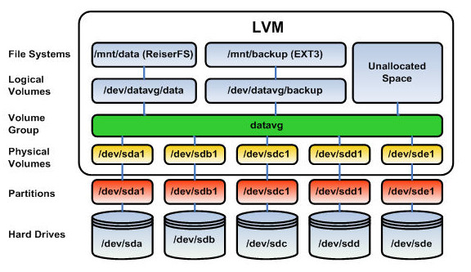

Slide 29
Init
  Stands for Initialization
  The first process started during the booting of the computer system
  daemon process that continues running until the system is shutdown
  A direct or indirect ancestor of all other processes
  automatically adopts all orphaned processes
  PID or Process ID is 1
  create processes from a script stored in /etc/inittab
    configuration file used by initialization system
    last step of kernel boot sequence

Slide 30
Init
  Init script initializes the service
  responsible for initializing the system
  init scripts are also called rc scripts (run command scripts)
  Also used in UNIX

Slide 31
Init - services
  Start a service
    service [service-name] start
  Stop a service
    service [service-name] stop
  restart a service
    service [service-name] restart
  reload a service
    service [service-name] reload
  service status
    service [service-name] status

Slide 32
Init - services
  Restart service if already running
    service [service-name] condrestart
  enable service at startup
    chkconfig [service-name] on
  disable service at startup
    chkconfig [service-name] off
  check if service is enabled at startup
    chkconfig [service-name]
  create new service file or modify configuration
    chkconfig [service-name] add

Slide 33
Run-levels
  State of init
  group of processes are defined to start at the startup of OS
  Mode of operation in the computer operating system
  Each run level has a certain number of services started or stopped

Slide 34
Run-levels
  Seven Run levels exist ($ runlevel digit or $ init digit)
    0: Shuts down the system
    1: single-user mode
    2: multi-user mode without networking
    3: multi-user mode with networking (with CLI)
    4: user-definable
    5: multi-user mode with networking (with GUI)
    6: reboots the system to restart it

Slide 35
Run-levels
  By default, Linux based systems boot on runlevel 3 or 5
  user can modify preset runlevels
  create new ones according to the requirements
  Runlevel 2 and 4 are used for user defined runlevels
  runlevel 0 and 6 aur used for shutdown and reboot the system

Slide 36
Systemd
  Systemd is the new init framework
  system and service manager for Linux operating systems
  new distros are moving to systemd
  managing services with systemd
    systemctl: control system and services
    journalctl: manage journal, systemd's logging system
    hostnamectl: control hostname
    localectl: configure locale and keyboard layout
    timedatectl: set time and date
    systemd-cgls: shows cgroup contents
    systemadm: front-end for systemctl

Slide 37
Systemd - services
  see all services (running or not)
    systemctl list-units --type service --all
  Start a service
    systemctl start [service-name]
  Stop a service
    systemctl stop [service-name]
  restart a service
    systemctl restart [service-name]
  reload a service
    systemctl reload [service-name]

Slide 38
Systemd - services
  see service status
    systemctl status [service-name]
  Restart a service if already running
    systemctl condrestart [service-name]
  Enable service at startup
    systemctl enable [service-name]
  Disable service at startup
    systemctl disable [service-name]
  check if service is enable at start up
    systemctl is-enabled [service-name]

Slide 39
Systemd - services
  create new serivce file or modify configuration
    systemctl daemon-reload
  systemctl halt
  systemctl poweroff
  systemctl reboot

Slide 40
Learning Objectives
Module 2 - Lecture 6
  Linux Permissions
  Disk Partition / Logical Volume Management
  Run levels / init / systemd

Slide 41
Next Lecture
Module 2 - Lecture 7
  Advanced commands

Slide 42

Ask Questions!!

